Slide 1

人工智能实践
Artificial Intelligence Practice
DCS3015 Autumn 2022
Chao Yu （余超）
School of Computer Science and Engineering
Sun Yat-Sen University

Slide 2
Lecture 7：Exploration and Exploitation
13th December. 2022

Slide 3
Exploration and Exploitation
Introduction of Exploration in RL
Basic Exploration Technique
Taxonomy of Exploration
Exploration in Single-agent RL
Exploration in Multi-agent RL

Slide 4
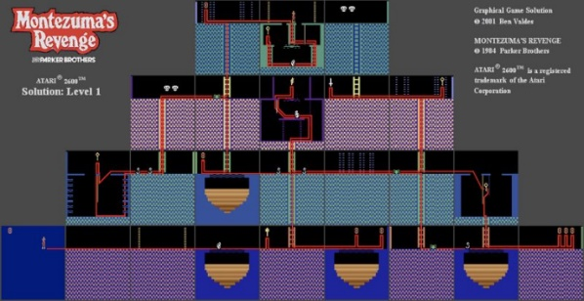
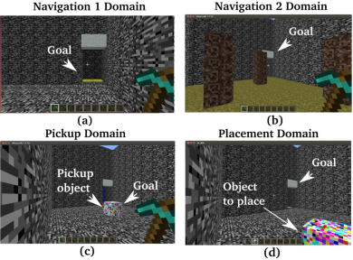
Introduction of Exploration in RL
Challenge
Sample-inefficiency
Millions of interactions
How to efficiently explore the unknown environments and collect informative experiences that could benefit the policy learning most towards optimal ones
Complex environment
Large state-action space
Sparse or delayed rewards
Noisy
Long horizons
Non-stationary
Local- and global- exploration
Yang, Tianpei, et al. "Exploration in deep reinforcement learning: a comprehensive survey." arXiv preprint arXiv:2109.06668 (2021).

Slide 5

Introduction of Exploration in RL
Example：Montezuma’s revenge
Getting key = reward
Opening door = reward
Getting killed by skull = nothing (is it good ? bad?)
Finishing the game only weakly correlates with rewarding events
We know what to do because we understand what these sprites mean!

Slide 6
Introduction of Exploration in RL
Two potential definitions of exploration problem
How can an agent discover high-reward strategies that require a temporally extended sequence of complex behaviors that, individually, are not rewarding?
How can an agent decide whether to attempt new behaviors (to discover ones with higher reward) or continue to do the best thing it knows so far?
Actually the same problem
Exploitation: doing what you know will yield highest reward
Exploration: doing things you haven’t done before, in the hopes of getting even higher reward
Exploration and exploitation examples
Restaurant selection
Exploitation: go to your favorite restaurant
Exploration: try to a new restaurant

Slide 7
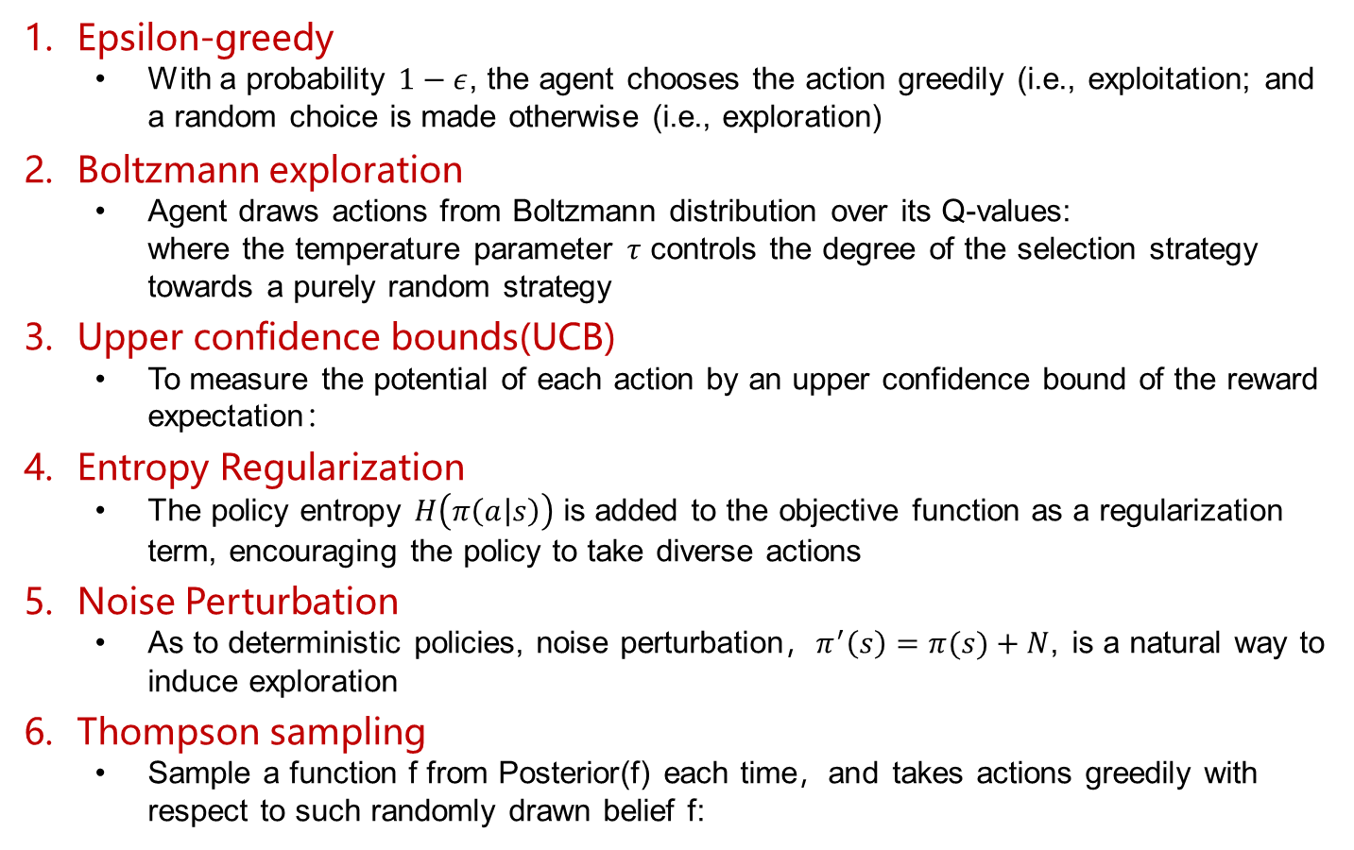
Basic Exploration Technique
Epsilon-greedy
With a probability $1−ε$, the agent chooses the action greedily (i.e., exploitation; and a random choice is made otherwise (i.e., exploration)
Boltzmann exploration
Agent draws actions from Boltzmann distribution over its Q-values: where the temperature parameter $τ$ controls the degree of the selection strategy towards a purely random strategy
Upper confidence bounds(UCB)
To measure the potential of each action by an upper confidence bound of the reward expectation：
Entropy Regularization
The policy entropy $H\left(π\left(a | s\right)\right)$ is added to the objective function as a regularization term, encouraging the policy to take diverse actions
Noise Perturbation
As to deterministic policies, noise perturbation，$π^{′}\left(s\right)=π(s)+N$, is a natural way to induce exploration
Thompson sampling
Sample a function f from Posterior(f) each time，and takes actions greedily with respect to such randomly drawn belief f:
Yang, Tianpei, et al. "Exploration in deep reinforcement learning: a comprehensive survey." arXiv preprint arXiv:2109.06668 (2021).

Slide 8
Taxonomy of Exploration
Uncertain-oriented
Optimism in the Face of Uncertainty(OFU)
To leverage the quantification of epistemic and aleatoric uncertainty as a general means to measure the sufficiency of learning and the intrinsic stochasticity
Intrinsic motivation-oriented
In developmental psychology, intrinsic motivation is considered as the primary driver in the early stages of human development, e.g., children often employ less goal-oriented exploration but by curiosity to gain the knowledge of the world
To make use of various reward-agnostic information as intrinsic motivation to guide exploration
Other
Yang, Tianpei, et al. "Exploration in deep reinforcement learning: a comprehensive survey." arXiv preprint arXiv:2109.06668 (2021).

Slide 9
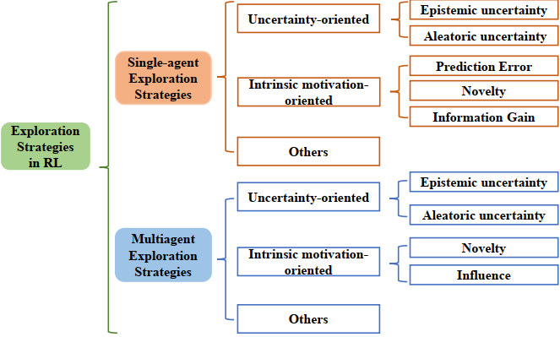
Taxonomy of Exploration
Yang, Tianpei, et al. "Exploration in deep reinforcement learning: a comprehensive survey." arXiv preprint arXiv:2109.06668 (2021).

Slide 10
Exploration in single-agent RL
Uncertain-oriented Exploration
Epistemic uncertainty (parametric uncertainty)
Considered as the errors that arise from insufficient and inaccurate knowledge about environment
OFU encourages the agent to visit states and actions with higher epistemic uncertainty to explore the unknown environment
How to estimate the epistemic uncertainty: MC dropout, bootstrap sampling, ensemble estimators
Common methods: RLSVI, Bayesian DQN, Bootstrap DQN, SUNRISE
Aleatoric uncertainty (return uncertainty)
Represents the intrinsic randomness of environment, and can be captured by the return distribution
Two ways:
UCB, a directly method for exploring states and actions with high uncertainty is performing optimistic action-selection by choosing the action to maximize the optimistic value function in each time step
Thompson Sampling, the action-selection is greedy to a sampled value function from the Q-posterior
Common methods: DUVN, IDS
Yang, Tianpei, et al. "Exploration in deep reinforcement learning: a comprehensive survey." arXiv preprint arXiv:2109.06668 (2021).

Slide 11
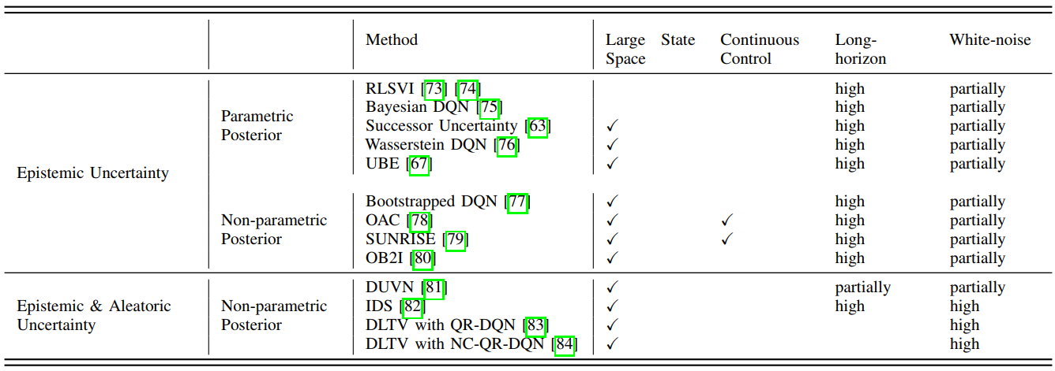
Exploration in single-agent RL
Uncertain-oriented Exploration
Parametric Posterior: learned by Bayesian regression in linear MDPS, where the transition and reward functions are assumed to be linear to state-action features
Yang, Tianpei, et al. "Exploration in deep reinforcement learning: a comprehensive survey." arXiv preprint arXiv:2109.06668 (2021).

Slide 12
Exploration in single-agent RL
Intrinsic Motivation-oriented Exploration
is originated from humans inherent tendency to be active, to interact with the world in an attempt to have an effect, and to feel a sense of accomplishment
It is usually accompanied with positive effects (rewards), thus intrinsic motivation-oriented exploration methods often design intrinsic rewards to create the sense of accomplishment for agents
Three categories:
Estimate prediction errors of the environmental dynamics
Estimate the state novelty
Based on information gain
Yang, Tianpei, et al. "Exploration in deep reinforcement learning: a comprehensive survey." arXiv preprint arXiv:2109.06668 (2021).

Slide 13
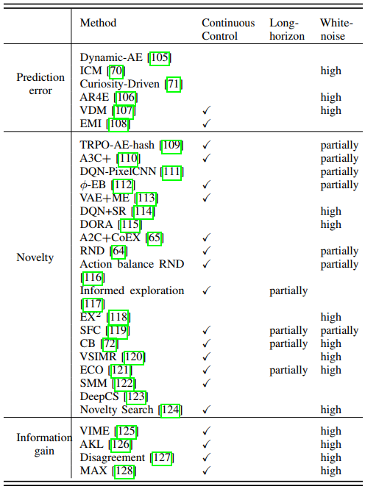
Exploration in single-agent RL
Intrinsic Motivation-oriented Exploration
Yang, Tianpei, et al. "Exploration in deep reinforcement learning: a comprehensive survey." arXiv preprint arXiv:2109.06668 (2021).

Slide 14
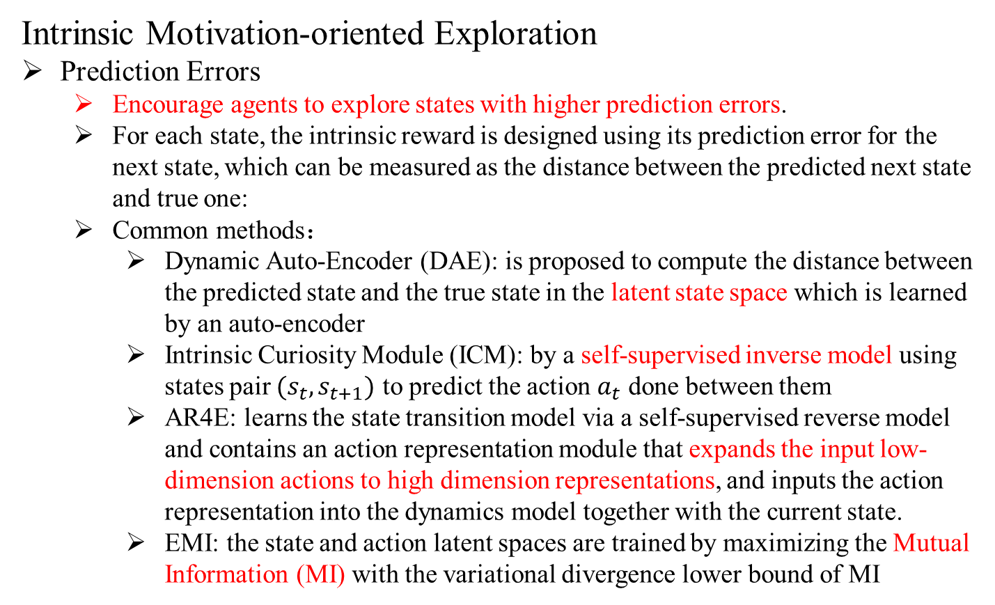
Exploration in single-agent RL
Intrinsic Motivation-oriented Exploration
Prediction Errors
Encourage agents to explore states with higher prediction errors.
For each state, the intrinsic reward is designed using its prediction error for the next state, which can be measured as the distance between the predicted next state and true one:
Common methods：
Dynamic Auto-Encoder (DAE): is proposed to compute the distance between the predicted state and the true state in the latent state space which is learned by an auto-encoder
Intrinsic Curiosity Module (ICM): by a self-supervised inverse model using states pair $(s_{t},s_{t+1})$ to predict the action $a_{t}$ done between them
AR4E: learns the state transition model via a self-supervised reverse model and contains an action representation module that expands the input low-dimension actions to high dimension representations, and inputs the action representation into the dynamics model together with the current state.
EMI: the state and action latent spaces are trained by maximizing the Mutual Information (MI) with the variational divergence lower bound of MI
Yang, Tianpei, et al. "Exploration in deep reinforcement learning: a comprehensive survey." arXiv preprint arXiv:2109.06668 (2021).

Slide 15
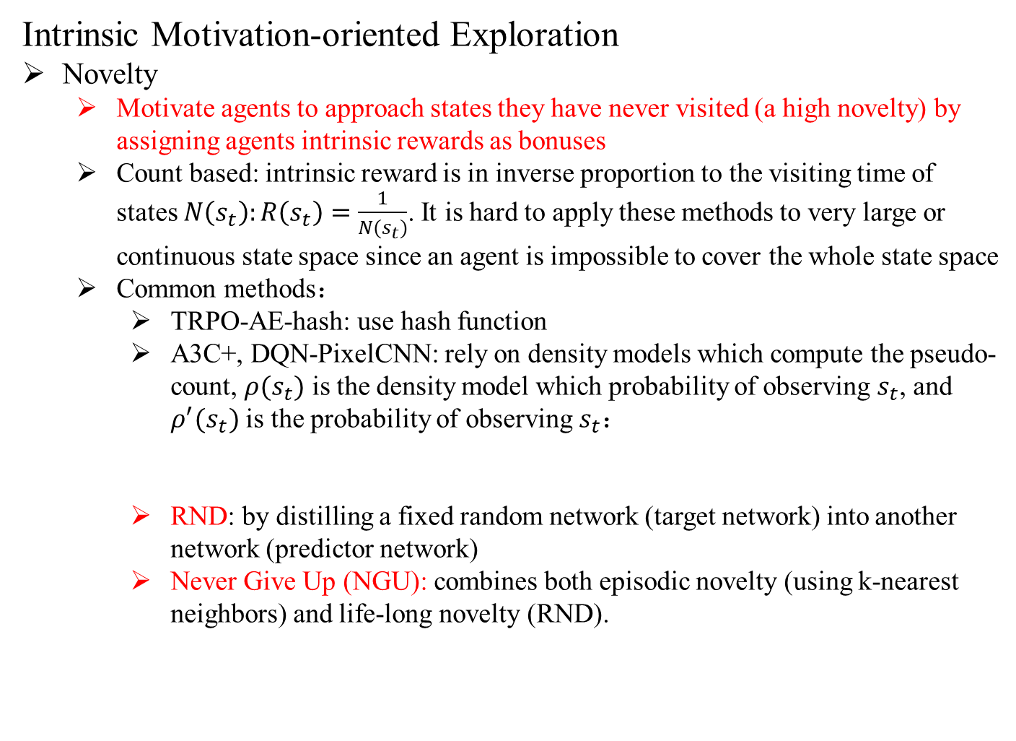
Exploration in single-agent RL
Intrinsic Motivation-oriented Exploration
Novelty
Motivate agents to approach states they have never visited (a high novelty) by assigning agents intrinsic rewards as bonuses
Count based: intrinsic reward is in inverse proportion to the visiting time of states $N\left(s_{t}\right):R\left(s_{t}\right)=\frac{1}{N(s_{t})}$. It is hard to apply these methods to very large or continuous state space since an agent is impossible to cover the whole state space
Common methods：
TRPO-AE-hash: use hash function
A3C+, DQN-PixelCNN: rely on density models which compute the pseudo-count, $ρ(s_{t})$ is the density model which probability of observing $s_{t}$, and $ρ^{′}(s_{t})$ is the probability of observing $s_{t}$：
RND: by distilling a fixed random network (target network) into another network (predictor network)
Never Give Up (NGU): combines both episodic novelty (using k-nearest neighbors) and life-long novelty (RND).
Yang, Tianpei, et al. "Exploration in deep reinforcement learning: a comprehensive survey." arXiv preprint arXiv:2109.06668 (2021).

Slide 16
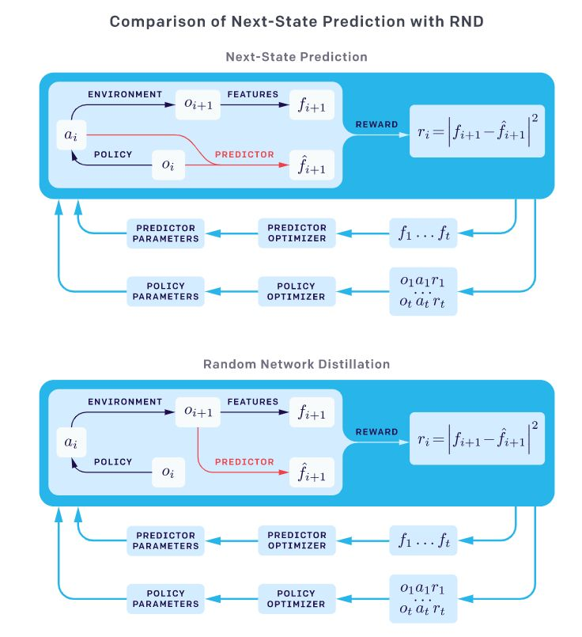
Exploration in single-agent RL
Intrinsic Motivation-oriented Exploration
Novelty
RND: by distilling a fixed random network (target network) into another network (predictor network)
Yang, Tianpei, et al. "Exploration in deep reinforcement learning: a comprehensive survey." arXiv preprint arXiv:2109.06668 (2021).

Slide 17
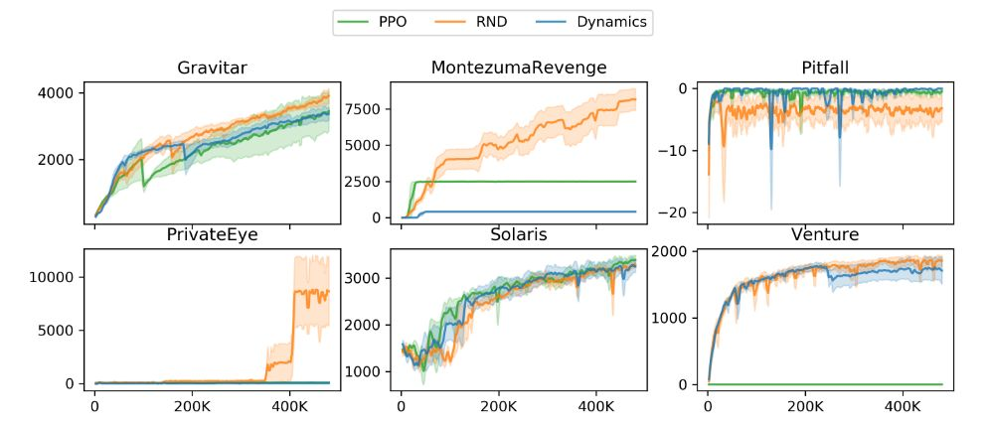
Exploration in single-agent RL
Intrinsic Motivation-oriented Exploration
Novelty
RND: by distilling a fixed random network (target network) into another network (predictor network)
Yang, Tianpei, et al. "Exploration in deep reinforcement learning: a comprehensive survey." arXiv preprint arXiv:2109.06668 (2021).

Slide 18
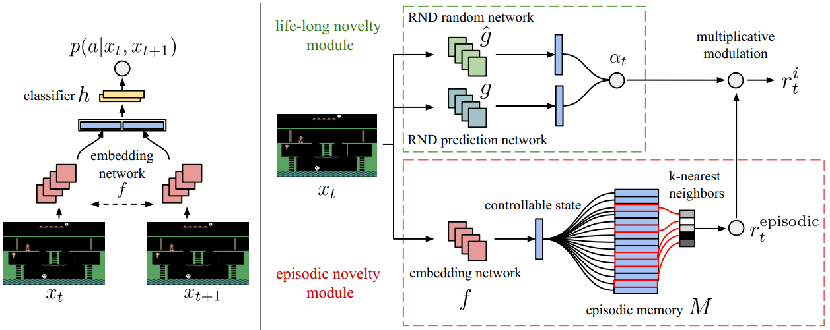
Exploration in single-agent RL
Intrinsic Motivation-oriented Exploration
Novelty
RND: by distilling a fixed random network (target network) into another network (predictor network)
Never Give Up (NGU): combines both episodic novelty (using k-nearest neighbors) and life-long novelty (RND).
Yang, Tianpei, et al. "Exploration in deep reinforcement learning: a comprehensive survey." arXiv preprint arXiv:2109.06668 (2021).

Slide 19
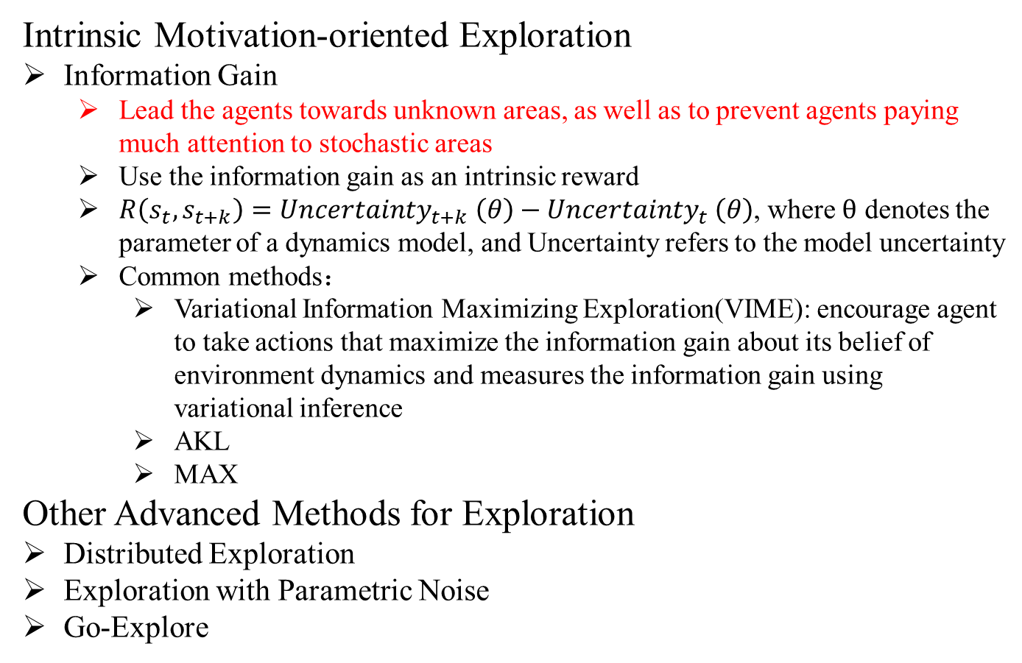
Exploration in single-agent RL
Intrinsic Motivation-oriented Exploration
Information Gain
Lead the agents towards unknown areas, as well as to prevent agents paying much attention to stochastic areas
Use the information gain as an intrinsic reward
$R\left(s_{t},s_{t+k}\right)={Uncertainty}_{t+k} \left(θ\right)−{Uncertainty}_{t} \left(θ\right)$, where $θ$ denotes the parameter of a dynamics model, and Uncertainty refers to the model uncertainty
Common methods：
Variational Information Maximizing Exploration(VIME): encourage agent to take actions that maximize the information gain about its belief of environment dynamics and measures the information gain using variational inference
AKL
MAX
Other Advanced Methods for Exploration
Distributed Exploration
Exploration with Parametric Noise
Go-Explore
Yang, Tianpei, et al. "Exploration in deep reinforcement learning: a comprehensive survey." arXiv preprint arXiv:2109.06668 (2021).

Slide 20
Exploration in single-agent RL
SUNRISE
Challenge
Balancing exploration and exploitation.
Q-learning often converges to sub-optimal solutions due to error propagation in the target value can lead to an increase in overall error in the Q-function
Main idea
A simple unified ensemble method
Two ingredients:
Ensemble-based weighted Bellman back-ups, which re-weight target Q-values based on uncertainty estimates from a Q-ensemble
An inference method that selects actions using the highest upper-confidence bounds for efficient exploration. By enforcing the diversity between agents using Bootstrap with random initialization.
Is compatible with various off-policy RL algorithms
SAC
Lee, Kimin, et al. "Sunrise: A simple unified framework for ensemble learning in deep reinforcement learning." International Conference on Machine Learning. PMLR, 2021.

Slide 21
Exploration in single-agent RL
SUNRISE
Soft Actor-Critic (SAC): is an off-policy actor-critic method based on the maximum entropy RL framework, which encourages the robustness to noise and exploration by maximizing a weighted objective of the reward and the policy entropy
Lee, Kimin, et al. "Sunrise: A simple unified framework for ensemble learning in deep reinforcement learning." International Conference on Machine Learning. PMLR, 2021.

Slide 22
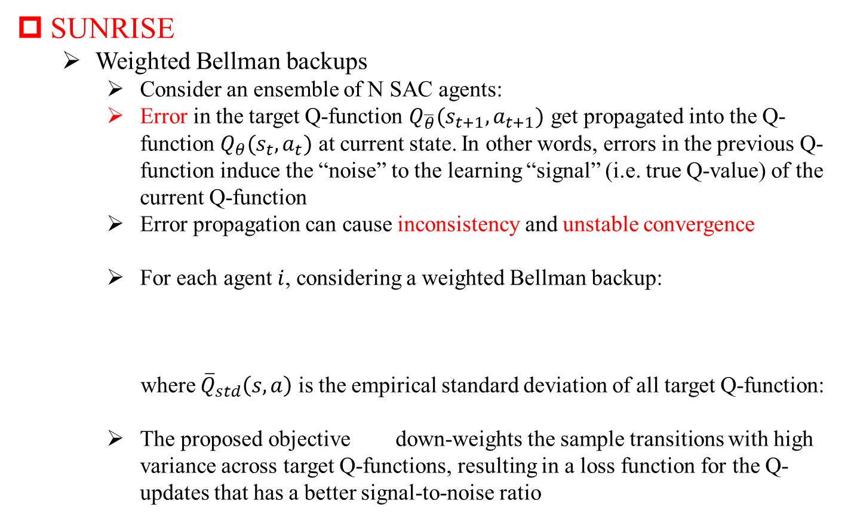
Exploration in single-agent RL
SUNRISE
Weighted Bellman backups
Consider an ensemble of N SAC agents:
Error in the target Q-function $Q_{\overline{θ}}(s_{t+1},a_{t+1})$ get propagated into the Q-function $Q_{θ}(s_{t},a_{t})$ at current state. In other words, errors in the previous Q-function induce the “noise” to the learning “signal” (i.e. true Q-value) of the current Q-function
Error propagation can cause inconsistency and unstable convergence
For each agent $i$, considering a weighted Bellman backup:
where ${\overline{Q}}_{std}\left(s,a\right)$ is the empirical standard deviation of all target Q-function:
The proposed objective down-weights the sample transitions with high variance across target Q-functions, resulting in a loss function for the Q-updates that has a better signal-to-noise ratio
Lee, Kimin, et al. "Sunrise: A simple unified framework for ensemble learning in deep reinforcement learning." International Conference on Machine Learning. PMLR, 2021.

Slide 23
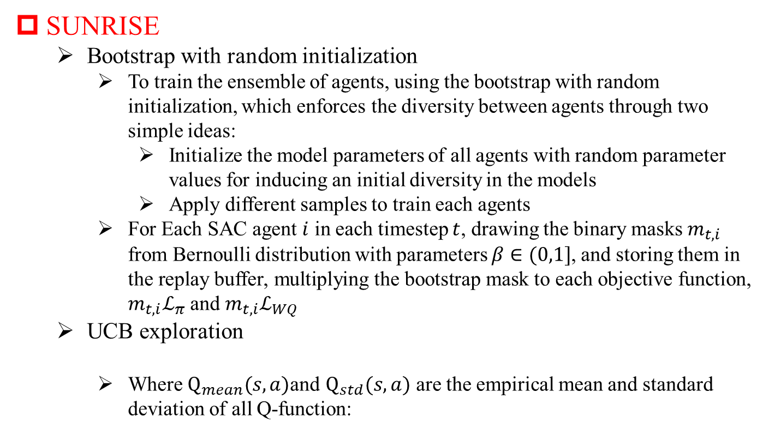
Exploration in single-agent RL
SUNRISE
Bootstrap with random initialization
To train the ensemble of agents, using the bootstrap with random initialization, which enforces the diversity between agents through two simple ideas:
Initialize the model parameters of all agents with random parameter values for inducing an initial diversity in the models
Apply different samples to train each agents
For Each SAC agent $i$ in each timestep $t$, drawing the binary masks $m_{t,i}$ from Bernoulli distribution with parameters $β∈(0,1]$, and storing them in the replay buffer, multiplying the bootstrap mask to each objective function, $m_{t,i}ℒ_{π}$ and $m_{t,i}ℒ_{WQ}$
UCB exploration
Where $Q_{mean}(s,a)$and $Q_{std}(s,a)$ are the empirical mean and standard deviation of all Q-function:
Lee, Kimin, et al. "Sunrise: A simple unified framework for ensemble learning in deep reinforcement learning." International Conference on Machine Learning. PMLR, 2021.

Slide 24
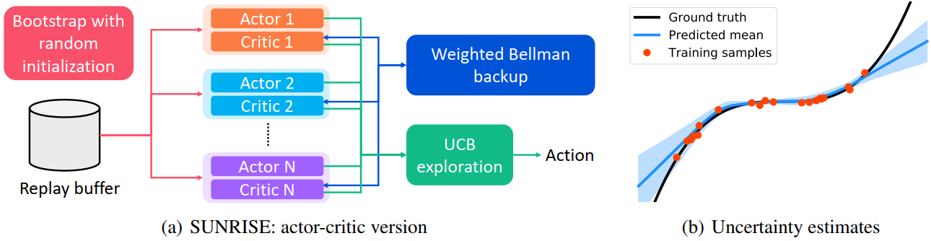
Exploration in single-agent RL
SUNRISE
Architecture
Lee, Kimin, et al. "Sunrise: A simple unified framework for ensemble learning in deep reinforcement learning." International Conference on Machine Learning. PMLR, 2021.

Slide 25
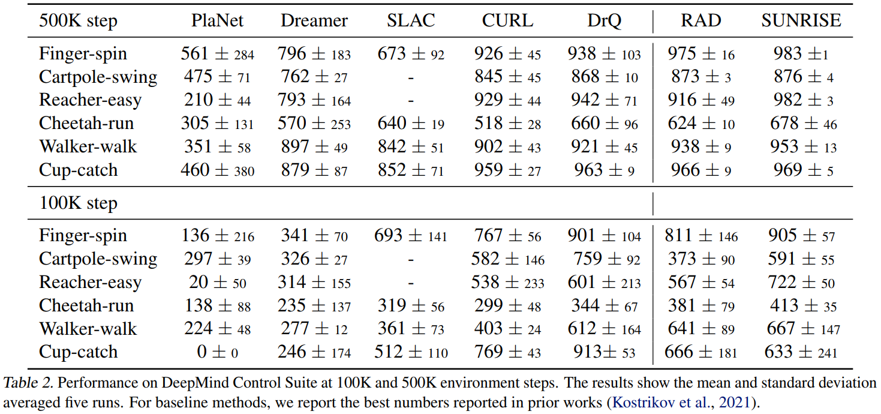
Exploration in single-agent RL
SUNRISE
Performance
Lee, Kimin, et al. "Sunrise: A simple unified framework for ensemble learning in deep reinforcement learning." International Conference on Machine Learning. PMLR, 2021.

Slide 26
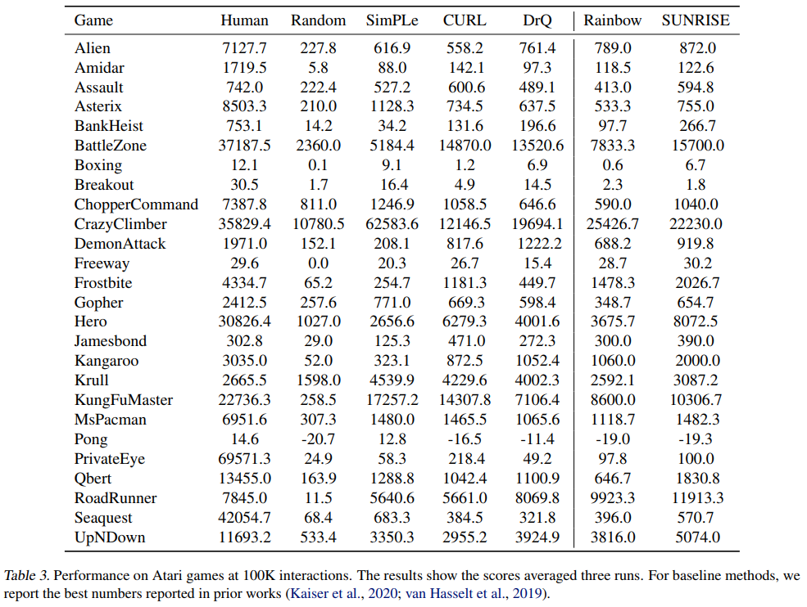
Exploration in single-agent RL
SUNRISE
Performance
Lee, Kimin, et al. "Sunrise: A simple unified framework for ensemble learning in deep reinforcement learning." International Conference on Machine Learning. PMLR, 2021.

Slide 27
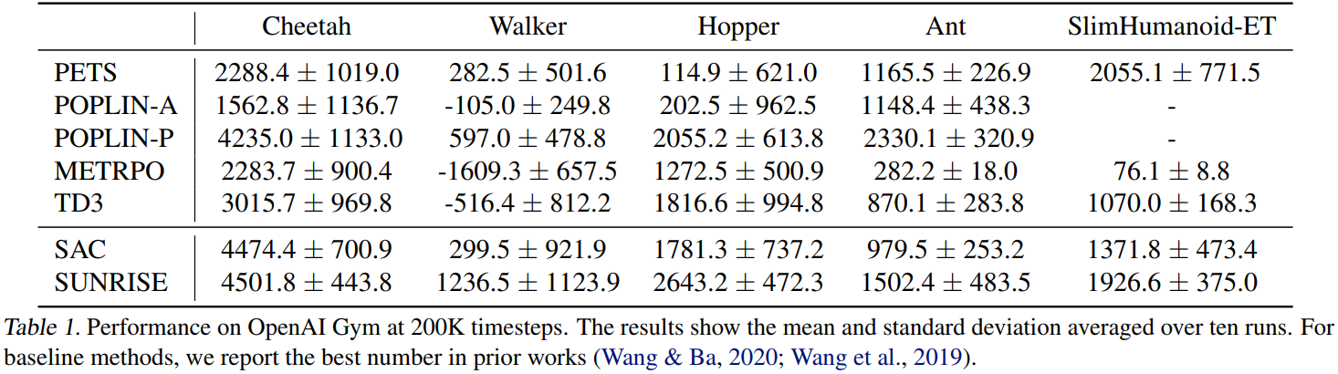
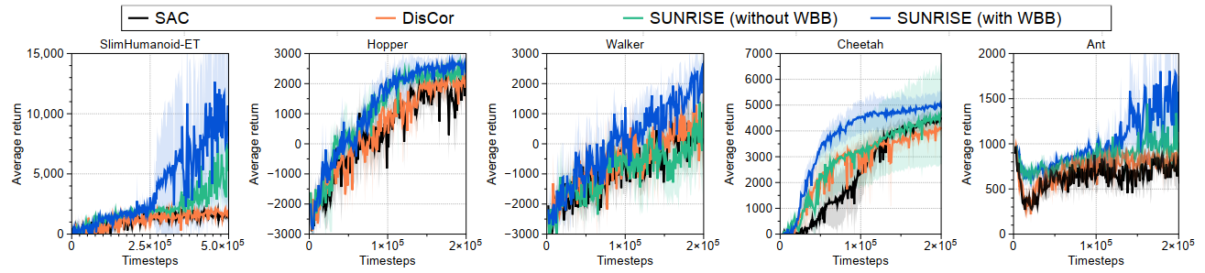
Exploration in single-agent RL
SUNRISE
Performance
Lee, Kimin, et al. "Sunrise: A simple unified framework for ensemble learning in deep reinforcement learning." International Conference on Machine Learning. PMLR, 2021.

Slide 28
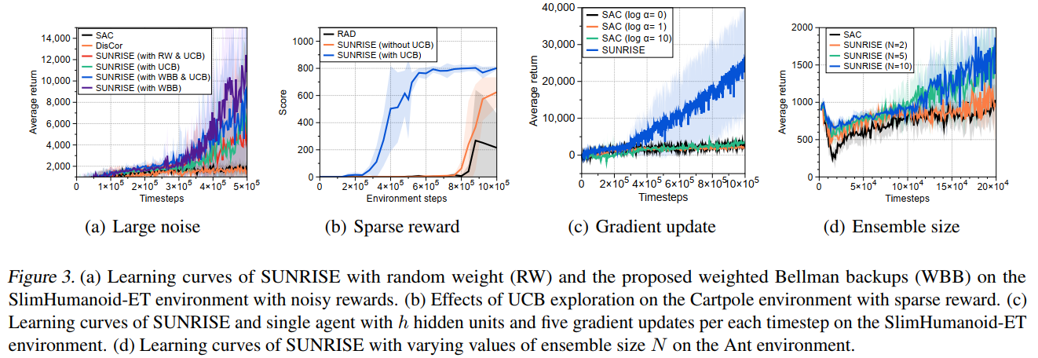
Exploration in single-agent RL
SUNRISE
Performance
Lee, Kimin, et al. "Sunrise: A simple unified framework for ensemble learning in deep reinforcement learning." International Conference on Machine Learning. PMLR, 2021.

Slide 29
Exploration in Multi-agent RL
Uncertain-oriented Exploration
Epistemic uncertainty
Multi-agent safe q-learning
Aleatoric uncertainty
Distributional value function
Intrinsic motivated-oriented
LIIR
Learn individual intrinsic reward to update a proxy critic for each agent
Update intrinsic reward network by global critic
EMC
Two networks: exploration and exploitation
Exploration network: make use of experience in replay buffer to update itself network and calculate the intrinsic reward which is measured by distance between exploration network and prediction network
Exploitation network: utilize the intrinsic reward and global reward to update the network and interact with environment
Other
Yang, Tianpei, et al. "Exploration in deep reinforcement learning: a comprehensive survey." arXiv preprint arXiv:2109.06668 (2021).

Slide 30
Exploration in single-agent RL
EMC
Challenge
In which space should we define curiosity?
The straightforward method is to measure curiosity on the global observation or joint histories in a centralized way. However, it is inefficient to find structured interaction between agents, which seems too sparse compared with the exponentially growing state space when the number of agents increases.
In contrast, if curiosity is defined as the novelty of local observation histories during the decentralized execution, although scalable, it still fails to guide agents to coordinate due to partial observability.
How to make the best use of experiences collected by the exploration strategy
Zheng, Lulu, et al. "Episodic multi-agent reinforcement learning with curiosity-driven exploration." Advances in Neural Information Processing Systems 34 (2021): 3757-3769.

Slide 31
Exploration in single-agent RL
EMC
Main idea
Utilizing the value factorization of the state-of-the-art multi-agent Q-learning approaches and defining the prediction errors of individual Q-value functions as intrinsic reward
it provides a novelty measure of joint observation histories with scalability because individual Q-values are latent embeddings of observation histories in factorized multi-agent Q-learning
it captures the influence from other agents due to the implicit credit assignment from global reward signal during centralized training, and biases exploration into promising states where strong interdependence may lie between agents.
Augmenting factorized multi-agent reinforcement learning with episodic memory
This memory stores and regularly updates the best returns for explored states.
Allowing fast latching onto past successful experience trajectories collected by curiosity-driven exploration and greatly improving learning efficiency
Zheng, Lulu, et al. "Episodic multi-agent reinforcement learning with curiosity-driven exploration." Advances in Neural Information Processing Systems 34 (2021): 3757-3769.

Slide 32



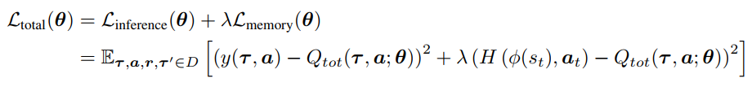
Exploration in single-agent RL
EMC
Curiosity-Driven Exploration by Predicting Individual Q-values
Intrinsic reward：
Updating equation：
Episodic Memory
Updating equation：
Zheng, Lulu, et al. "Episodic multi-agent reinforcement learning with curiosity-driven exploration." Advances in Neural Information Processing Systems 34 (2021): 3757-3769.

Slide 33
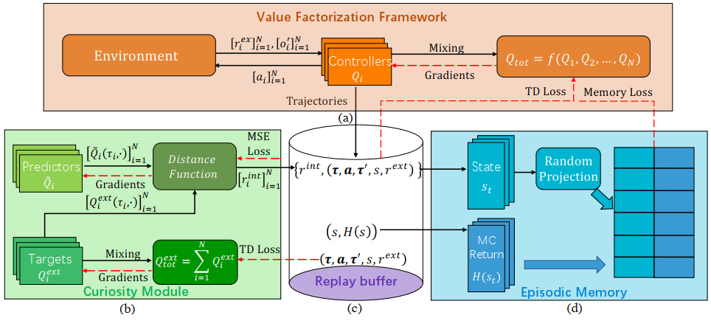
Exploration in single-agent RL
EMC
Architecture
Zheng, Lulu, et al. "Episodic multi-agent reinforcement learning with curiosity-driven exploration." Advances in Neural Information Processing Systems 34 (2021): 3757-3769.

Slide 34
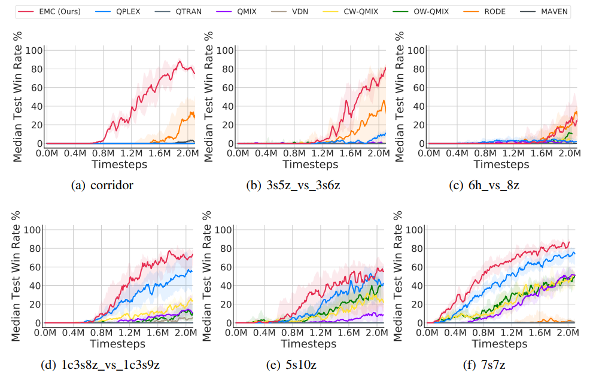
Exploration in single-agent RL
EMC
Performance
Zheng, Lulu, et al. "Episodic multi-agent reinforcement learning with curiosity-driven exploration." Advances in Neural Information Processing Systems 34 (2021): 3757-3769.

Slide 35
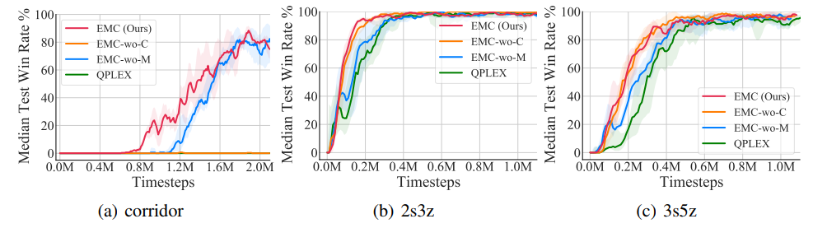
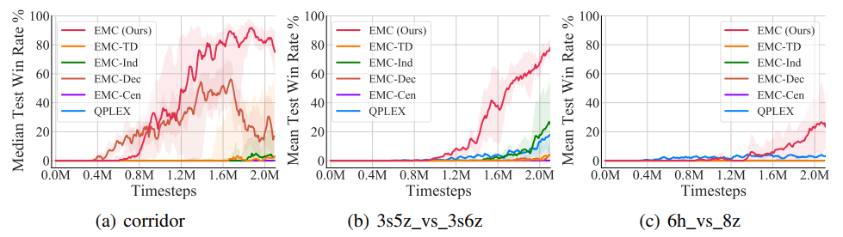
Exploration in single-agent RL
EMC
Performance
Zheng, Lulu, et al. "Episodic multi-agent reinforcement learning with curiosity-driven exploration." Advances in Neural Information Processing Systems 34 (2021): 3757-3769.

Slide 36
Deep Reinforcement Learning
谢 谢！
中山大学计算机学院

